Slide 1
PHP- Advance
Tutor- Jatinder Singh

Slide 2
PHP Date and Time
PHP Date( ) Function: The PHP date() function convert a timestamp to a more readable date and time.
The computer stores dates and times in a format called UNIX Timestamp, which measures time as a number of seconds since the beginning of the Unix epoch (midnight Greenwich Mean Time on January 1, 1970 i.e. January 1, 1970 00:00:00 GMT ).
Since this is an impractical format for humans to read, PHP converts a timestamp to a format that is readable to humans and dates from your notation into a timestamp the computer understands. The syntax of the PHP date() function can be given with.

Slide 3
Continue..
date(format, timestamp)
The format parameter in the date() function is required which specifies the format of returned date and time. However the timestamp is an optional parameter, if not included then current date and time will be used. The following statement displays today's date:
<?php
$today = date("d/m/Y");
echo $today;
?>

Slide 4
Formatting the Dates and Times with PHP
The format parameter of the date() function is in fact a string that can contain multiple characters allowing you to generate a date string containing various components of the date and time, like day of the week, AM or PM, etc. Here are some the date-related formatting characters that are commonly used in format string:
d - Represent day of the month; two digits with leading zeros (01 or 31)
D - Represent day of the week in text as an abbreviation (Mon to Sun)
m - Represent month in numbers with leading zeros (01 or 12)
M - Represent month in text, abbreviated (Jan to Dec)
y - Represent year in two digits (08 or 14)
Y - Represent year in four digits (2008 or 2014)

Slide 5
Example
<?php
echo date("d/m/Y") . "<br>";
echo date("d-m-Y") . "<br>";
echo date("d.m.Y");
?>

Slide 6
Format the time string
Similarly you can use the following characters to format the time string:
h - Represent hour in 12-hour format with leading zeros (01 to 12)
H - Represent hour in in 24-hour format with leading zeros (00 to 23)
i - Represent minutes with leading zeros (00 to 59)
s - Represent seconds with leading zeros (00 to 59)
a - Represent lowercase ante meridiem and post meridiem (am or pm)
A - Represent uppercase Ante meridiem and Post meridiem (AM or PM)

Slide 7
Example
<?php
echo date("h:i:s") . "<br>";
echo date("F d, Y h:i:s A") . "<br>";
echo date("h:i a");
?>

Slide 8
The PHP time() Function
The time() function is used to get the current time as a Unix timestamp (the number of seconds since the beginning of the Unix epoch: January 1 1970 00:00:00 GMT).
Example:
<?php
// Executed at March 05, 2014 07:19:18
$timestamp = time();
echo($timestamp);
?>

Slide 9
The PHP mktime() Function
The mktime() function is used to create the timestamp based on a specific date and time. If no date and time is provided, the timestamp for the current date and time is returned.
The syntax of the mktime() function can be given with:
mktime(hour, minute, second, month, day, year)
Example
<?php
// Create the timestamp for a particular date
echo mktime(15, 20, 12, 5, 10, 2014);
?>

Slide 10
Continue..
The mktime() function can be used to find the weekday name corresponding to a particular date. To do this, simply use the 'l' (lowercase 'L') character with your timestamp, as in the following example, which displays the day that falls on April 1, 2014:
<?php
// Get the weekday name of a particular date
echo date('l', mktime(0, 0, 0, 1, 4, 2014));
?>

Slide 11
PHP Include and Require Files

Slide 12
Including a PHP File into Another PHP File
The include() and require() statement allow you to include the code contained in a PHP file within another PHP file. Including a file produces the same result as copying the script from the file specified and pasted into the location where it is called.
You can save a lot of time and work through including files — Just store a block of code in a separate file and include it wherever you want using the include() and require() statements instead of typing the entire block of code multiple times.
A typical example is including the header, footer and menu file within all the pages of a website.

Slide 13
Syntax
The basic syntax of the include() and require() statement can be given with:
include("path/to/filename"); -Or- include "path/to/filename";
require("path/to/filename"); -Or- require "path/to/filename";

Slide 14
Example
<!DOCTYPE html> <html lang="en">
<head><title>Tutorial Republic</title> </head><body>
<?php include "header.php"; ?>
<?php include "menu.php"; ?>
<h1>Welcome to Our Website!</h1>
<p>Here you will find lots of useful information.</p>
<?php include "footer.php"; ?>
</body> </html>

Slide 15
Difference Between include and require Statements
The only difference is — the include() statement will only generate a PHP warning but allow script execution to continue if the file to be included can't be found, whereas the require() statement will generate a fatal error and stops the script execution.

Slide 16
Example
<?php require "my_variables.php"; ?>
<?php require "my_functions.php"; ?>
<!DOCTYPE html> <html lang="en"><head> <title><?php displayTitle($home_page); ?> </title></head>
<body> <?php include "header.php"; ?>
<?php include "menu.php"; ?>
<h1>Welcome to Our Website!</h1>
<p>Here you will find lots of useful information.</p>
<?php include "footer.php"; ?>
</body></html>

Slide 17
The include_once and require_once Statements
If you accidentally include the same file (typically functions or classes files) more than one time within your code using the include or require statements, it may cause conflicts. To prevent this situation, PHP provides include_once and require_once statements. These statements behave in the same way as include and require statements with one exception.
The include_once and require_once statements will only include the file once even if asked to include it a second time i.e. if the specified file has already been included in a previous statement, the file is not included again.

Slide 18
PHP File System

Slide 19
Opening a File with PHP fopen() Function
To work with a file you first need to open the file. The PHP fopen() function is used to open a file. The basic syntax of this function is:
fopen(filename, mode)
The first parameter passed to fopen() specifies the name of the file you want to open, and the second parameter specifies in which mode the file should be opened. For example:
<?php
$handle = fopen("data.txt", "r");
?>

Slide 20
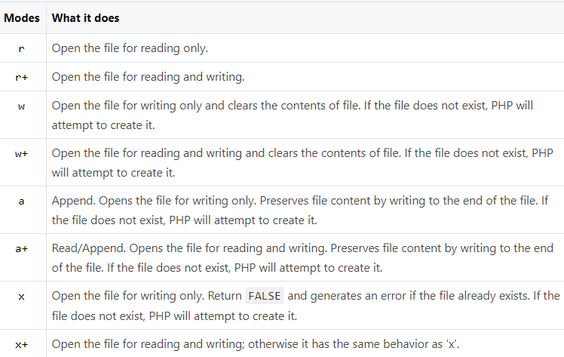
Modes
Note: If you try to open a file that doesn't exist, PHP will generate a warning message. So, to avoid these error messages you should always implement a simple check whether a file or directory exists or not before trying to access it, with the PHP file_exists() function.

Slide 21
Example
<?php
$file = "data.txt";
// Check the existence of file
if(file_exists($file)) { // Attempt to open the file
$handle = fopen($file, "r");
} else{
echo "ERROR: File does not exist."; }
?>

Slide 22
Closing a File with PHP fclose() Function
Once you've finished working with a file, it needs to be closed. The fclose() function is used to close the file. For Example:
<?php $file = "data.txt";
// Check the existence of file
if(file_exists($file)){ // Open the file for reading
$handle = fopen($file, "r") or die("ERROR: Cannot open the file.");
/* Some code to be executed */ // Closing the file handle fclose($handle);
} else{
echo "ERROR: File does not exist.";
} ?>

Slide 23
Reading from Files with PHP fread() Function
PHP has several functions for reading data from a file. You can read from just one character to the entire file with a single operation.
Reading Fixed Number of Characters: The fread() function can be used to read a specified number of characters from a file. The basic syntax of this function can be given with.
fread(file handle, length in bytes)
This function takes two parameter — A file handle and the number of bytes to read.

Slide 24
Continue..
Reading the Entire Contents of a File: The fread() function can be used in conjugation with the filesize() function to read the entire file at once. The filesize() function returns the size of the file in bytes.
Writing the Files Using PHP fwrite() Function: You can write data to a file or append to an existing file using the PHP fwrite() function. The basic syntax of this function can be given with:
fwrite(file handle, string)
The fwrite() function takes two parameter — A file handle and the string of data that is to be written,

Slide 25
Renaming Files with PHP rename() Function
You can rename a file or directory using the PHP's rename() function, like this:
<?php
$file = "file.txt"; // Check the existence of file
if(file_exists($file)) { // Attempt to rename the file
if(rename($file, "newfile.txt")){
echo "File renamed successfully.";
} else{
echo "ERROR: File cannot be renamed."; }
} else{ echo "ERROR: File does not exist.";
} ?>

Slide 26
Removing Files with PHP unlink() Function
You can delete files or directories using the PHP's unlink() function, like this:
<?php
$file = "note.txt"; // Check the existence of file
if(file_exists($file)){ // Attempt to delete the file
if(unlink($file)){
echo "File removed successfully.";
} else{ echo "ERROR: File cannot be removed.";
}} else{
echo "ERROR: File does not exist.";
} ?>

Slide 27
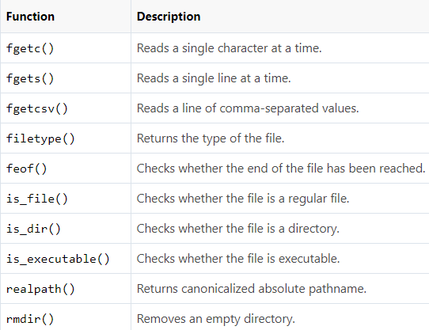
PHP Filesystem Functions

Slide 28
PHP Parsing Directories

Slide 29
Creating a New Directory
You can create a new and empty directory by calling the PHP mkdir() function with the path and name of the directory to be created, as shown in the example below:
<?php // The directory path
$dir = "testdir"; // Check the existence of directory
if(!file_exists($dir)){ // Attempt to create directory
if(mkdir($dir)){ echo "Directory created successfully."; } else{
echo "ERROR: Directory could not be created."; }
} else{echo "ERROR: Directory already exists.";
}?>
To make the mkdir() function work, the parent directories in the directory path parameter has to exist already, for example, if you specify the directory path as testdir/subdir than the testdir has to exist otherwise PHP will generate an error.

Slide 30
Copying Files from One Location to Another
You can copy a file from one location to another by calling PHP copy() function with the file's source and destination paths as arguments. If the destination file already exists it'll be overwritten.
Listing All Files in a Directory: You can use the PHP scandir() function to list files and directories inside the specified path.
Listing All Files of a Certain Type: While working on directory and file structure, sometimes you might need to find out certain types of files within the directory, for example, listing only .text or .png files, etc. You can do this easily with the PHP glob() function, which matches files based on the pattern.

Slide 31
Uploading Files with PHP
You can upload any kind of file like images, videos, ZIP files, Microsoft Office documents, PDFs, as well as executables files and a wide range of other file types.
Step 1: Creating an HTML form to upload the file
<!DOCTYPE html><html lang="en">
<head><title>File Upload Form</title></head>
<body><form action="upload-manager.php" method="post" enctype="multipart/form-data"> <h2>Upload File</h2>
<label for="fileSelect">Filename:</label> <input type="file" name="photo" id="fileSelect">
<input type="submit" name="submit" value="Upload">
<p><strong>Note:</strong> Only .jpg, .jpeg, .gif, .png formats allowed to a max size of 5 MB.</p></form></body></html>

Slide 32
Step 2: Processing the uploaded file
<?php// Check if the form was submitted if($_SERVER["REQUEST_METHOD"] == "POST"){// Check if file was uploaded without errors
if(isset($_FILES["photo"]) && $_FILES["photo"]["error"] == 0){
$allowed = array("jpg" => "image/jpg", "jpeg" => "image/jpeg", "gif" => "image/gif", "png" => "image/png");
$filename = $_FILES["photo"]["name"];$filetype = $_FILES["photo"]["type"];$filesize = $_FILES["photo"]["size"]; // Verify file extension
$ext = pathinfo($filename, PATHINFO_EXTENSION);
if(!array_key_exists($ext, $allowed)) die("Error: Please select a valid file format."); // Verify file size - 5MB maximum
$maxsize = 5 * 1024 * 1024;
if($filesize > $maxsize) die("Error: File size is larger than the allowed limit."); // Verify MYME type of the file
if(in_array($filetype, $allowed)){ // Check whether file exists before uploading it
if(file_exists("upload/" . $filename)){ echo $filename . " is already exists.";
} else{ move_uploaded_file($_FILES["photo"]["tmp_name"], "upload/" . $filename);echo "Your file was uploaded successfully.";
} } else{echo "Error: There was a problem uploading your file. Please try again.";
}} else{echo "Error: " . $_FILES["photo"]["error"];}}?>

Slide 33
Downloading Files with PHP
Normally, you don't necessarily need to use any server side scripting language like PHP to download images, zip files, pdf documents, exe files, etc. If such kind of file is stored in a public accessible folder, you can just create a hyperlink pointing to that file, and whenever a user click on the link, browser will automatically downloads that file.
<a href="downloads/test.zip">Download Zip file</a>
<a href="downloads/masters.pdf">Download PDF file</a>
<a href="downloads/sample.jpg">Download Image file</a>
<a href="downloads/setup.exe">Download EXE file</a>

Slide 34
Forcing a Download Using PHP
You can force images or other kind of files to download directly to the user's hard drive using the PHP readfile() function. Here we're going to create a simple image gallery that allows users to download the image files from the browser with a single mouse click.

Slide 35
PHP Cookies
What is a Cookie: A cookie is a small text file that lets you store a small amount of data (nearly 4KB) on the user's computer. They are typically used to keeping track of information such as username that the site can retrieve to personalize the page when user visit the website next time.
Setting a Cookie in PHP: The setcookie() function is used to set a cookie in PHP. Make sure you call the setcookie() function before any output generated by your script otherwise cookie will not set. The basic syntax of this function can be given with: setcookie(name, value, expire, path, domain, secure);

Slide 36
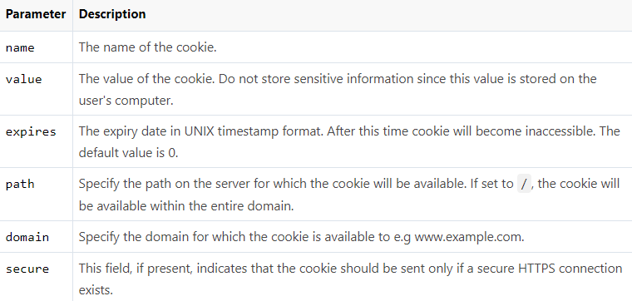
The parameters of the setcookie()

Slide 37
Example
Here's an example that uses setcookie() function to create a cookie named username and assign the value value John Carter to it. It also specify that the cookie will expire after 30 days (30 days * 24 hours * 60 min * 60 sec).
<?php
// Setting a cookie
setcookie("username", "John Carter", time()+30*24*60*60);
?>

Slide 38
Accessing Cookies Values
The PHP $_COOKIE superglobal variable is used to retrieve a cookie value. It typically an associative array that contains a list of all the cookies values sent by the browser in the current request, keyed by cookie name. The individual cookie value can be accessed using standard array notation, for example to display the username cookie set in the previous example, you could use the following code.
<?php
// Accessing an individual cookie value
echo $_COOKIE["username"]; ?>

Slide 39
Removing Cookies
You can delete a cookie by calling the same setcookie() function with the cookie name and any value (such as an empty string) however this time you need the set the expiration date in the past, as shown in the example below:
<?php
// Deleting a cookie
setcookie("username", "", time()-3600);
?>

Slide 40
PHP Sessions
What is a Session: Although you can store data using cookies but it has some security issues. Since cookies are stored on user's computer it is possible for an attacker to easily modify a cookie content to insert potentially harmful data in your application that might break your application.
Also every time the browser requests a URL to the server, all the cookie data for a website is automatically sent to the server within the request. It means if you have stored 5 cookies on user's system, each having 4KB in size, the browser needs to upload 20KB of data each time the user views a page, which can affect your site's performance.
You can solve both of these issues by using the PHP session. A PHP session stores data on the server rather than user's computer. In a session based environment, every user is identified through a unique number called session identifier or SID. This unique session ID is used to link each user with their own information on the server like emails, posts, etc.

Slide 41
Starting a PHP Session
Before you can store any information in session variables, you must first start up the session. To begin a new session, simply call the PHP session_start() function. It will create a new session and generate a unique session ID for the user.
<?php // Starting session
session_start(); ?>
The session_start() function first checks to see if a session already exists by looking for the presence of a session ID. If it finds one, i.e. if the session is already started, it sets up the session variables and if doesn't, it starts a new session by creating a new session ID.

Slide 42
Storing and Accessing Session Data
You can store all your session data as key-value pairs in the $_SESSION[] superglobal array. The stored data can be accessed during lifetime of a session. Consider the following script, which creates a new session and registers two session variables.
<?php // Starting session
session_start(); // Storing session data
$_SESSION["firstname"] = "Peter";
$_SESSION["lastname"] = "Parker"; ?>
To access the session data we set on our previous example from any other page on the same web domain — simply recreate the session by calling session_start() and then pass the corresponding key to the $_SESSION associative array.

Slide 43
Destroying a Session
If you want to remove certain session data, simply unset the corresponding key of the $_SESSION associative array, as shown in the following example:
<?php // Starting session
session_start(); // Removing session data
if(isset($_SESSION["lastname"])){
unset($_SESSION["lastname"]);
}?>

Slide 44
Continue..
However, to destroy a session completely, simply call the session_destroy() function. This function does not need any argument and a single call destroys all the session data.
<?php
// Starting sessionsession_start();
// Destroying session session_destroy();
?>
Every PHP session has a timeout value — a duration, measured in seconds — which determines how long a session should remain alive in the absence of any user activity. You can adjust this timeout duration by changing the value of session.gc_maxlifetime variable in the PHP configuration file (php.ini).

Slide 45
The PHP mail() Function
Sending email messages are very common for a web application, for example, sending welcome email when a user create an account on your website, sending newsletters to your registered users, or getting user feedback or comment through website's contact form, and so on.
You can use the PHP built-in mail() function for creating and sending email messages to one or more recipients dynamically from your PHP application either in a plain-text form or formatted HTML. The basic syntax of this function can be given with: mail(to, subject, message, headers, parameters)

Slide 46
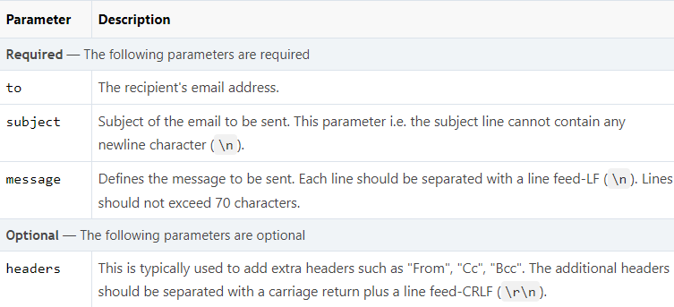
Parameters

Slide 47
Sending Plain Text Emails
The simplest way to send an email with PHP is to send a text email. In the example below we first declare the variables — recipient's email address, subject line and message body — then we pass these variables to the mail() function to send the email.
<?php $to = 'maryjane@email.com';
$subject = 'Marriage Proposal';
$message = 'Hi Jane, will you marry me?';
$from = 'peterparker@email.com'; // Sending email
if(mail($to, $subject, $message)){
echo 'Your mail has been sent successfully.';
} else{ echo 'Unable to send email. Please try again.';}?>

Slide 48
Sending HTML Formatted Emails
When you send a text message using PHP, all the content will be treated as simple text. We're going to improve that output, and make the email into a HTML-formatted email.
To send an HTML email, the process will be the same. However, this time we need to provide additional headers as well as an HTML formatted message.

Slide 49
Example
<?php $to = 'maryjane@email.com'; $subject = 'Marriage Proposal';
$from = 'peterparker@email.com'; // To send HTML mail, the Content-type header must be set $headers = 'MIME-Version: 1.0' . "\r\n";
$headers .= 'Content-type: text/html; charset=iso-8859-1' . "\r\n"; // Create email headers $headers .= 'From: '.$from."\r\n".
'Reply-To: '.$from."\r\n" 'X-Mailer: PHP/' . phpversion(); // Compose a simple HTML email message $message = '<html><body>';
$message .= '<h1 style="color:#f40;">Hi Jane!</h1>'; $message .= '<p style="color:#080;font-size:18px;">Will you marry me?</p>';
$message .= '</body></html>'; // Sending email
if(mail($to, $subject, $message, $headers)){ echo 'Your mail has been sent successfully.';
} else{ echo 'Unable to send email. Please try again.';}?>

Slide 50
PHP Form Handling
Creating a Simple Contact Form: Create a simple HMTL contact form that allows users to enter their comment and feedback then displays it to the browser using PHP.

Slide 51
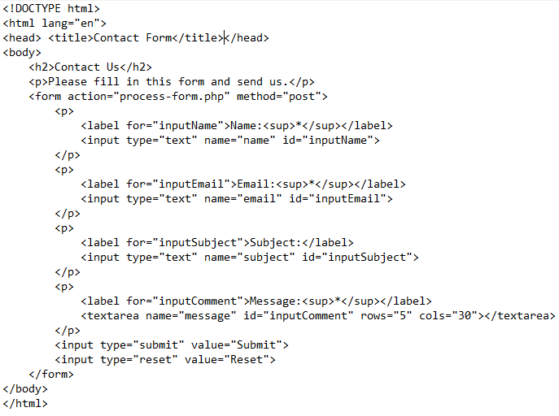
Example

Slide 52
Continue..
When a user submit the above contact form through clicking the submit button, the form data is sent to the "process-form.php" file on the server for processing. It simply captures the information submitted by the user and displays it to browser.

Slide 53
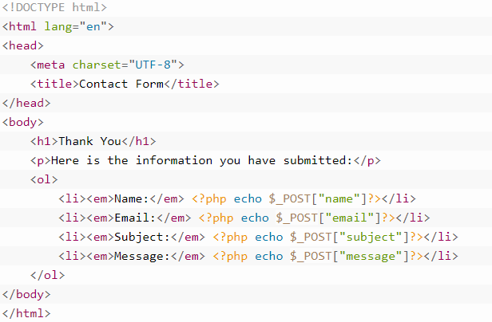
Continue..
The PHP code here is quite simple. Since the form data is sent through the post method, you can retrieve the value of a particular form field by passing its name to the $_POST superglobal array, and displays each field value using echo() statement.
In real world you cannot trust the user inputs; you must implement some sort of validation to filter the user inputs before using them. In the next chapter you will learn how sanitize and validate this contact form data and send it through the email using PHP.

Slide 54
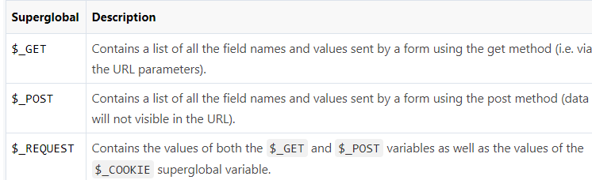
Capturing Form Data with PHP
To access the value of a particular form field, you can use the following superglobal variables. These variables are available in all scopes throughout a script.

Slide 55
PHP Form Validation
Sanitizing and Validating Form Data: Some basic security feature like sanitization and validation of the user's input so that user can not insert potentially harmful data that compromise the website security or might break the application. The following is our all-in-one PHP script which does the following things:
It will ask the users to enter his comments about the website.
The same script displays the contact form and process the submitted form data.
The script sanitizes and validates the user inputs. If any required field (marked with *) is missing or validation failed due to incorrect inputs the script redisplays the form with an error message for corresponding form field.
The script remembers which fields the user has already filled in, and prefills those fields when the form redisplayed due to validation error.
If the data submitted by the user are acceptable and everything goes well it will send an email to the website administrator and display a success message to the user.

Slide 56
PHP Filters
Validating and Sanitizing Data with Filters: Sanitizing and validating user input is one of the most common tasks in a web application. To make this task easier PHP provides native filter extension that you can use to sanitize or validate data such as e-mail addresses, URLs, IP addresses, etc.
To validate data using filter extension you need to use the PHP's filter_var() function. The basic syntax of this function can be given with: filter_var(variable, filter, options)
This function takes three parameters out of which the last two are optional. The first parameter is the value to be filtered, the second parameter is the ID of the filter to apply, and the third parameter is the array of options related to filter.

Slide 57
Sanitize a String
<?php
// Sample user comment
$comment = "<h1>Hey there! How are you doing today?</h1>";
// Sanitize and print comment string
$sanitizedComment = filter_var($comment, FILTER_SANITIZE_STRING);
echo $sanitizedComment; ?>

Slide 58
Validate Integer Values
<?php
// Sample integer value
$int = 20;
// Validate sample integer value
if(filter_var($int, FILTER_VALIDATE_INT)){
echo "The <b>$int</b> is a valid integer";
} else{
echo "The <b>$int</b> is not a valid integer";
} ?>

Slide 59
Validate IP Addresses
<?php
// Sample IP address
$ip = "172.16.254.1";
// Validate sample IP address
if(filter_var($ip, FILTER_VALIDATE_IP)){
echo "The <b>$ip</b> is a valid IP address";
} else {
echo "The <b>$ip</b> is not a valid IP address";
}?>

Slide 60
Sanitize and Validate Email Addresses
<?php
// Sample email address
$email = "someone@@example.com";
// Remove all illegal characters from email
$email = filter_var($email, FILTER_SANITIZE_EMAIL);
// Validate e-mail address
if(filter_var($email, FILTER_VALIDATE_EMAIL)){
echo "The <b>$email</b> is a valid email address";
} else{
echo "The <b>$email</b> is not a valid email address";}?>

Slide 61
Sanitize and Validate URLs
<?php
// Sample website url
$url = "http:://www.example.com";
// Remove all illegal characters from url
$url = filter_var($url, FILTER_SANITIZE_URL);
// Validate website url
if(filter_var($url, FILTER_VALIDATE_URL)){
echo "The <b>$url</b> is a valid website url";
} else{
echo "The <b>$url</b> is not a valid website url";}?>

Slide 62
Validate Integers Within a Range
The following example will validate whether the supplied value is an integer or not, as well as whether it lies within the range of 0 to 100 or not.
<?php
// Sample integer value
$int = 75;
// Validate sample integer value
if(filter_var($int, FILTER_VALIDATE_INT, array("options" => array("min_range" => 0,"max_range" => 100)))){
echo "The <b>$int</b> is within the range of 0 to 100";
} else{
echo "The <b>$int</b> is not within the range of 0 to 100";}?>

Slide 63
PHP Error Handling
Handling Errors: Sometimes your application will not run as it supposed to do, resulting in an error. There are a number of reasons that may cause errors, for example:
The Web server might run out of disk space
A user might have entered an invalid value in a form field
The file or database record that you were trying to access may not exist
The application might not have permission to write to a file on the disk
A service that the application needs to access might be temporarily unavailable
These types of errors are known as runtime errors, because they occur at the time the script runs. They are distinct from syntax errors that need to be fixed before the script will run. A professional application must have the capabilities to handle such runtime error gracefully. Usually this means informing the user about the problem more clearly and precisely.

Slide 64
Understanding Error Levels
Usually, when there's a problem that prevents a script from running properly, the PHP engine triggers an error. Each error is represented by an integer value and an associated constant.

Slide 65
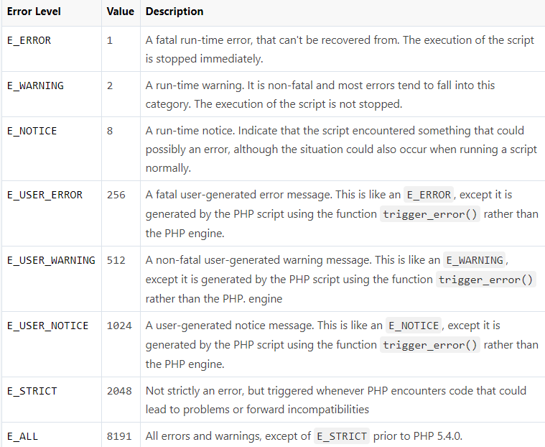

Slide 66
Basic Error Handling Using the die() Function
<?php
// Try to open a non-existent file
$file = fopen("sample.txt", "r");
?>
If the file does not exist you might get an error like this:
Warning: fopen(sample.txt) [function.fopen]: failed to open stream: No such file or directory in C:\wamp\www\project\test.php on line 2

Slide 67
Continue..
<?php
if(file_exists("sample.txt")){ $file = fopen("sample.txt", "r");
} else{ die("Error: The file you are trying to access doesn't exist.");}?>
Now if you run the above script you will get the error message like this:
Error: The file you are trying to access doesn't exist.
As you can see by implementing a simple check whether the file exist or not before trying to access it, we can generate an error message that is more meaningful to the user.
The die() function used above simply display the custom error message and terminate the current script if 'sample.txt' file is not found.

Slide 68
Creating a Custom Error Handler
You can create your own error handler function to deal with the run-time error generated by PHP engine. The custom error handler provides you greater flexibility and better control over the errors, it can inspect the error and decide what to do with the error, it might display a message to the user, log the error in a file or database or send by e-mail, attempt to fix the problem and carry on, exit the execution of the script or ignore the error altogether.

Slide 69
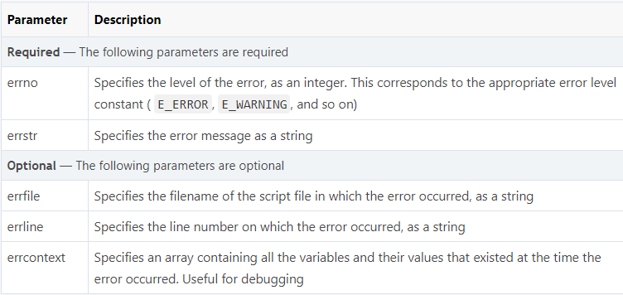
Continue..

Slide 70
PHP Classes and Objects
What is Object Oriented Programming: Object-Oriented Programming (OOP) is a programming model that is based on the concept of classes and objects. As opposed to procedural programming where the focus is on writing procedures or functions that perform operations on the data, in object-oriented programming the focus is on the creations of objects which contain both data and functions together.

Slide 71
Understanding Classes and Objects
Classes and objects are the two main aspects of object-oriented programming. A class is a self-contained, independent collection of variables and functions which work together to perform one or more specific tasks, while objects are individual instances of a class.
A class acts as a template or blueprint from which lots of individual objects can be created. When individual objects are created, they inherit the same generic properties and behaviors, although each object may have different values for certain properties.

Slide 72
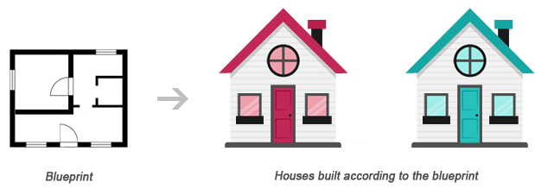
Continue..
For example, think of a class as a blueprint for a house. The blueprint itself is not a house, but is a detailed plan of the house. While, an object is like an actual house built according to that blueprint. We can build several identical houses from the same blueprint, but each house may have different paints, interiors and families inside, as shown in the illustration below.

Slide 73
Continue..
A class can be declared using the class keyword, followed by the name of the class and a pair of curly braces ({}), as shown in the following example.
Let's create a PHP file named Rectangle.php

Slide 74
Continue..
<?php
class Rectangle
{ // Declare properties
public $length = 0;
public $width = 0; // Method to get the perimeter
public function getPerimeter(){
return (2 * ($this->length + $this->width));
} // Method to get the area
public function getArea(){
return ($this->length * $this->width); }} ?>

Slide 75
Continue..
The arrow symbol (->) is an OOP construct that is used to access contained properties and methods of a given object. Whereas, the pseudo-variable $this provides a reference to the calling object i.e. the object to which the method belongs.

Slide 76
Using Constructors and Destructors
To make the object-oriented programming easier, PHP provides some magic methods that are executed automatically when certain actions occur within an object.
For example, the magic method __construct() (known as constructor) is executed automatically whenever a new object is created. Similarly, the magic method __destruct() (known as destructor) is executed automatically when the object is destroyed. A destructor function cleans up any resources allocated to an object once the object is destroyed.

Slide 77
Example
<?php
class MyClass
{ // Constructor
public function __construct(){
echo 'The class "' . __CLASS__ . '" was initiated!<br>';
} // Destructor
public function __destruct(){
echo 'The class "' . __CLASS__ . '" was destroyed.<br>';}}
// Create a new object
$obj = new MyClass; // Output a message at the end of the file
echo "The end of the file is reached.";?>

Slide 78
Extending Classes through Inheritance
Classes can inherit the properties and methods of another class using the extends keyword. This process of extensibility is called inheritance. It is probably the most powerful reason behind using the object-oriented programming model.

Slide 79
Controlling the Visibility of Properties and Methods
When working with classes, you can even restrict access to its properties and methods using the visibility keywords for greater control. There are three visibility keywords (from most visible to least visible): public, protected, private, which determines how and from where properties and methods can be accessed and modified.
Public — A public property or method can be accessed anywhere, from within the class and outside. This is the default visibility for all class members in PHP.
Protected — A protected property or method can only be accessed from within the class itself or in child or inherited classes i.e. classes that extends that class.
Private — A private property or method is accessible only from within the class that defines it. Even child or inherited classes cannot access private properties or methods.

Slide 80
Static Properties and Methods
In addition to the visibility, properties and methods can also be declared as static, which makes them accessible without needing an instantiation of the class. Static properties and methods can be accessed using the scope resolution operator (::), like this: ClassName::$property and ClassName::method().
A property declared as static cannot be accessed via the object of that class though a static method

Slide 81
PHP Magic Constants
What is Magic Constants: In the PHP constants chapter we've learned how to define and use constants in PHP script.
PHP moreover also provide a set of special predefined constants that change depending on where they are used. These constants are called magic constants. For example, the value of __LINE__ depends on the line that it's used on in your script.
Magic constants begin with two underscores and end with two underscores. The following section describes some of the most useful magical PHP constants.

Slide 82
__LINE__
The __LINE__ constant returns the current line number of the file, like this:
<?php
echo "Line number " . __LINE__ . "<br>"; // Displays: Line number 2
echo "Line number " . __LINE__ . "<br>"; // Displays: Line number 3
echo "Line number " . __LINE__ . "<br>"; // Displays: Line number 4
?>

Slide 83
__FILE__
The __FILE__ constant returns full path and name of the PHP file that's being executed. If used inside an include, the name of the included file is returned.
<?php
// Displays the absolute path of this file
echo "The full path of this file is: " . __FILE__;
?>

Slide 84
__DIR__
The __DIR__ constant returns the directory of the file. If used inside an include, the directory of the included file is returned. Here's an example:
<?php
// Displays the directory of this file
echo "The directory of this file is: " . __DIR__;
?>

Slide 85
__FUNCTION__
The __FUNCTION__ constant returns the name of the current function.
<?php
function myFunction(){
echo "The function name is - " . __FUNCTION__;
}
myFunction(); // Displays: The function name is - myFunction
?>

Slide 86
__CLASS__
The __CLASS__ constant returns the name of the current class. Here's an example:
<?php
class MyClass
{
public function getClassName(){
return __CLASS__;
}}
$obj = new MyClass();
echo $obj->getClassName(); // Displays: MyClass
?>

Slide 87
__METHOD__
The __METHOD__ constant returns the name of the current class method.
<?php
class Sample
{
public function myMethod(){
echo __METHOD__;
}}
$obj = new Sample();
$obj->myMethod(); // Displays: Sample::myMethod
?>

Slide 88
__NAMESPACE__
The __NAMESPACE__ constant returns the name of the current namespace.
<?php
namespace MyNamespace;
class MyClass
{
public function getNamespace(){
return __NAMESPACE__;
}}
$obj = new MyClass();
echo $obj->getNamespace(); // Displays: MyNamespace
?>

Slide 89
PHP JSON Parsing
What is JSON: JSON stands for JavaScript Object Notation. JSON is a standard lightweight data-interchange format which is quick and easy to parse and generate.
JSON, like XML, is a text-based format that's easy to write and easy to understand for both humans and computers, but unlike XML, JSON data structures occupy less bandwidth than their XML versions. JSON is based on two basic structures:
Object: This is defined as a collection of key/value pairs (i.e. key:value). Each object begins with a left curly bracket { and ends with a right curly bracket }. Multiple key/value pairs are separated by a comma ,.
Array: This is defined as an ordered list of values. An array begins with a left bracket [ and ends with a right bracket ]. Values are separated by a comma ,.
In JSON, keys are always strings, while the value can be a string, number, true or false, null or even an object or an array. Strings must be enclosed in double quotes " and can contain escape characters such as \n, \t and \. A JSON object may look like this:
Continue…………

Slide 90
Example
{
"book": {
"name": "Harry Potter and the Goblet of Fire",
"author": "J. K. Rowling",
"year": 2000,
"genre": "Fantasy Fiction",
"bestseller": true
}}

Slide 91
Parsing JSON with PHP
JSON data structures are very similar to PHP arrays. PHP has built-in functions to encode and decode JSON data. These functions are json_encode() and json_decode(), respectively. Both functions only works with UTF-8 encoded string data.
Encoding JSON Data in PHP: In PHP the json_encode() function is used to encode a value to JSON format. The value being encoded can be any PHP data type except a resource, like a database or file handle. The below example demonstrates how to encode a PHP associative array into a JSON object:
<?php// An associative array
$marks = array("Peter"=>65, "Harry"=>80, "John"=>78, "Clark"=>90);
echo json_encode($marks); ?>

Slide 92
Decoding JSON Data in PHP
Decoding JSON data is as simple as encoding it. You can use the PHP json_decode() function to convert the JSON encoded string into appropriate PHP data type. The following example demonstrates how to decode or convert a JSON object to PHP object.
<?php
// Store JSON data in a PHP variable
$json = '{"Peter":65,"Harry":80,"John":78,"Clark":90}';
var_dump(json_decode($json));
?>

Slide 93
PHP Regular Expressions
What is Regular Expression: Regular Expressions, commonly known as "regex" or "RegExp", are a specially formatted text strings used to find patterns in text. Regular expressions are one of the most powerful tools available today for effective and efficient text processing and manipulations.
For example, it can be used to verify whether the format of data i.e. name, email, phone number, etc. entered by the user was correct or not, find or replace matching string within text content, and so on.
PHP (version 5.3 and above) supports Perl style regular expressions via its preg_ family of functions. Why Perl style regular expressions? Because Perl (Practical Extraction and Report Language) was the first mainstream programming language that provided integrated support for regular expressions and it is well known for its strong support of regular expressions and its extraordinary text processing and manipulation capabilities.

Slide 94
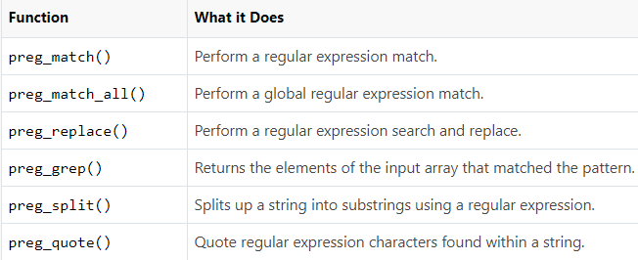
Continue..

Slide 95
Regular Expression Syntax
Regular expression syntax includes the use of special characters (do not confuse with the HTML special characters). The characters that are given special meaning within a regular expression, are: . * ? + [ ] ( ) { } ^ $ | \. You will need to backslash these characters whenever you want to use them literally. For example, if you want to match ".", you'd have to write \.. All other characters automatically assume their literal meanings.

Slide 96
Character Classes
Square brackets surrounding a pattern of characters are called a character class e.g. [abc]. A character class always matches a single character out of a list of specified characters that means the expression [abc] matches only a, b or c character.
Negated character classes can also be defined that match any character except those contained within the brackets. A negated character class is defined by placing a caret (^) symbol immediately after the opening bracket, like this [^abc].

Slide 97
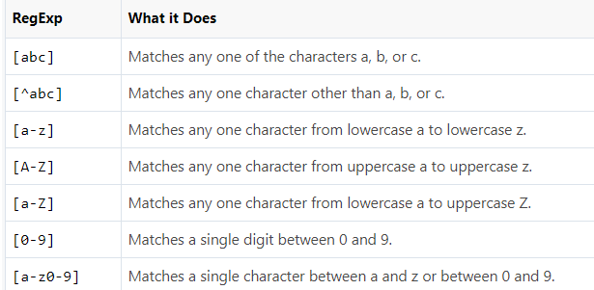
Continue..

Slide 98
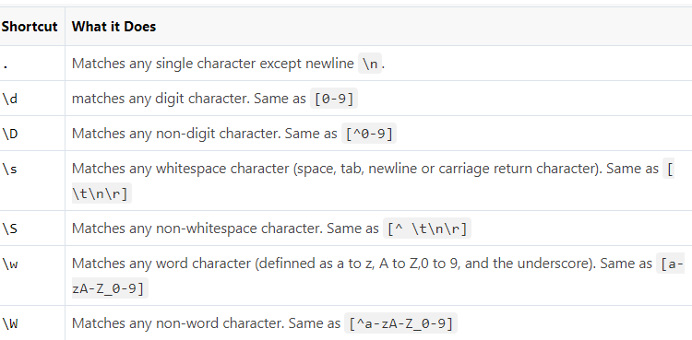
Predefined Character Classes
The following table lists those predefined character classes:

Slide 99
Repetition Quantifiers
If you want to match on more than one character? For example, let's say you want to find out words containing one or more instances of the letter p, or words containing at least two p's, and so on. This is where quantifiers come into play. With quantifiers you can specify how many times a character in a regular expression should match.

Slide 100
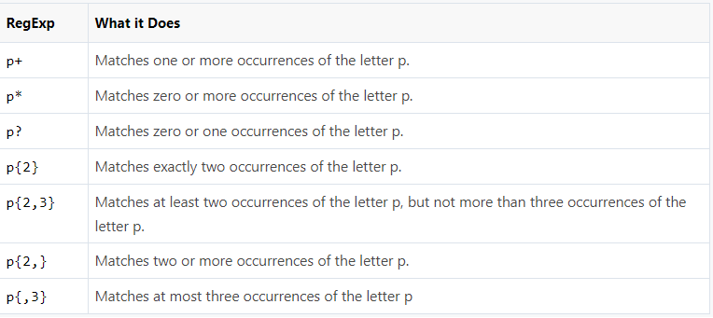
Continue..

Slide 101
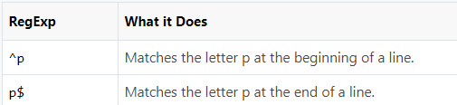
Position Anchors
There are certain situations where you want to match at the beginning or end of a line, word, or string. To do this you can use anchors. Two common anchors are caret (^) which represent the start of the string, and the dollar ($) sign which represent the end of the string.

Slide 102
Pattern Modifiers
A pattern modifier allows you to control the way a pattern match is handled. Pattern modifiers are placed directly after the regular expression, for example, if you want to search for a pattern in a case-insensitive manner, you can use the i modifier, like this: /pattern/i.

Slide 103
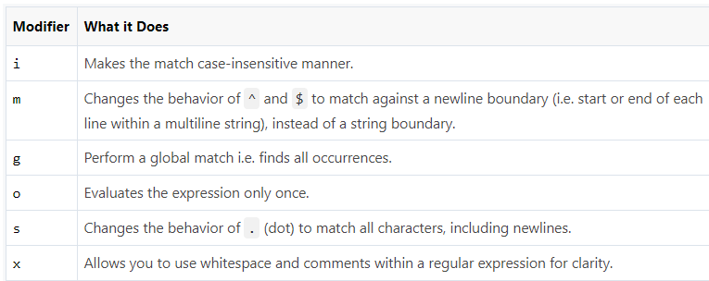
Pattern Modifier Table

Slide 104
Word Boundaries
A word boundary character ( \b) helps you search for the words that begins and/or ends with a pattern. For example, the regexp /\bcar/ matches the words beginning with the pattern car, and would match cart, carrot, or cartoon, but would not match oscar.
Similarly, the regexp /car\b/ matches the words ending with the pattern car, and would match scar, oscar, or supercar, but would not match cart. Likewise, the /\bcar\b/ matches the words beginning and ending with the pattern car, and would match only the word car.

Slide 105
PHP Exception Handling
What is an Exception: An exception is a signal that indicates some sort of exceptional event or error has occurred. Exceptions can be caused due to various reasons, for example, database connection or query fails, file that you're trying to access doesn't exist, and so on.
PHP provides a powerful exception handling mechanism that allows you to handle exceptions in a graceful way. As opposed to PHP's traditional error-handling system, exception handling is the object-oriented method for handling errors, which provides more controlled and flexible form of error reporting. Exception model was first introduced in PHP 5.

Slide 106
Using Throw and Try...Catch Statements
In exception-based approach, program code is written in a try block, an exception can be thrown using the throw statement when an exceptional event occurs during the execution of code in a try block. It is then caught and resolved by one or more catch blocks.

Slide 107
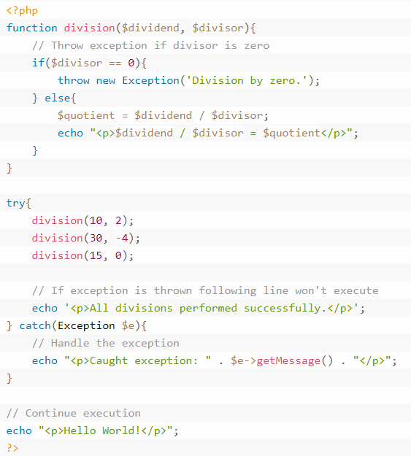
Example

Slide 108
Defining Custom Exceptions
You can even define your own custom exception handlers to treat different types of exceptions in a different way. It allows you to use a separate catch block for each exception type.
You can define a custom exception by extending the Exception class, because Exception is the base class for all exceptions. The custom exception class inherits all the properties and methods from PHP's Exception class. You can also add your custom methods to the custom exception class.

Slide 109
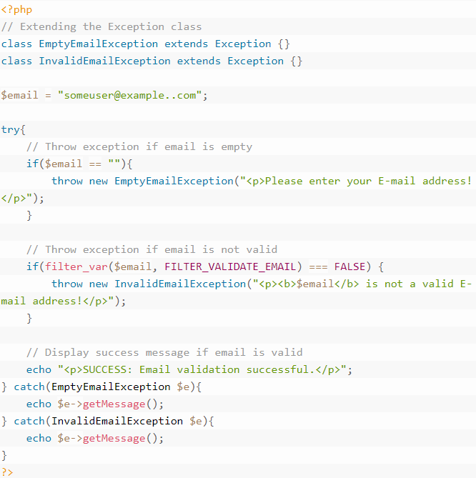
Example

Slide 110
Setting a Global Exception Handler
As we've discussed earlier in this chapter if an exception is not caught, PHP generates a Fatal Error with an "Uncaught Exception ..." message. This error message may contain sensitive information like file name and line number where the problem occurs. If you don't want to expose such information to the user, you can create a custom function and register it with the set_exception_handler() function to handle all uncaught exceptions.

Slide 111
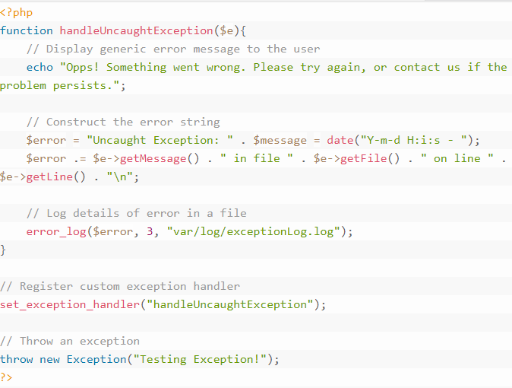
Example

Slide 112
Any Question???

